Slide 1
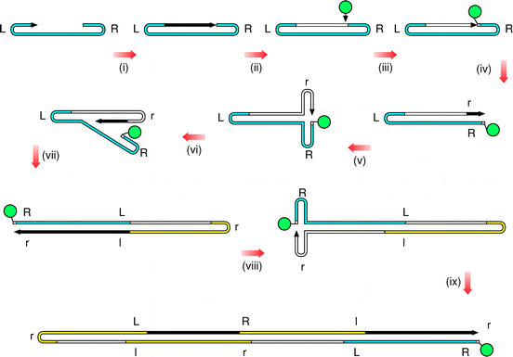
mRF
cRF
dRF
Notes:
Rolling hairpin replication. The sequence of the parental parvoviral genome is shown in blue, and those of progeny genomes are shown in yellow. The green circle represents NS1, which nicks the covalently‐continuous monomer and remains attached to its 5′ end. DNA, which is newly synthesized in each step, is indicated by the black bar with an arrow at its 3′ end. L and R depict the palindromic sequences at each terminus, with their complements represented by l and r, respectively. Step (ix) produces a tetramer in which there are three progeny genomes, in addition to the parental sequence. These genomic sequences overlap and are distributed throughout the molecule on alternate strands.

